Slide 1
R Markdown
Or: your r script just got pretty
Dr Erin I walsh | 15/03/2019

Slide 2
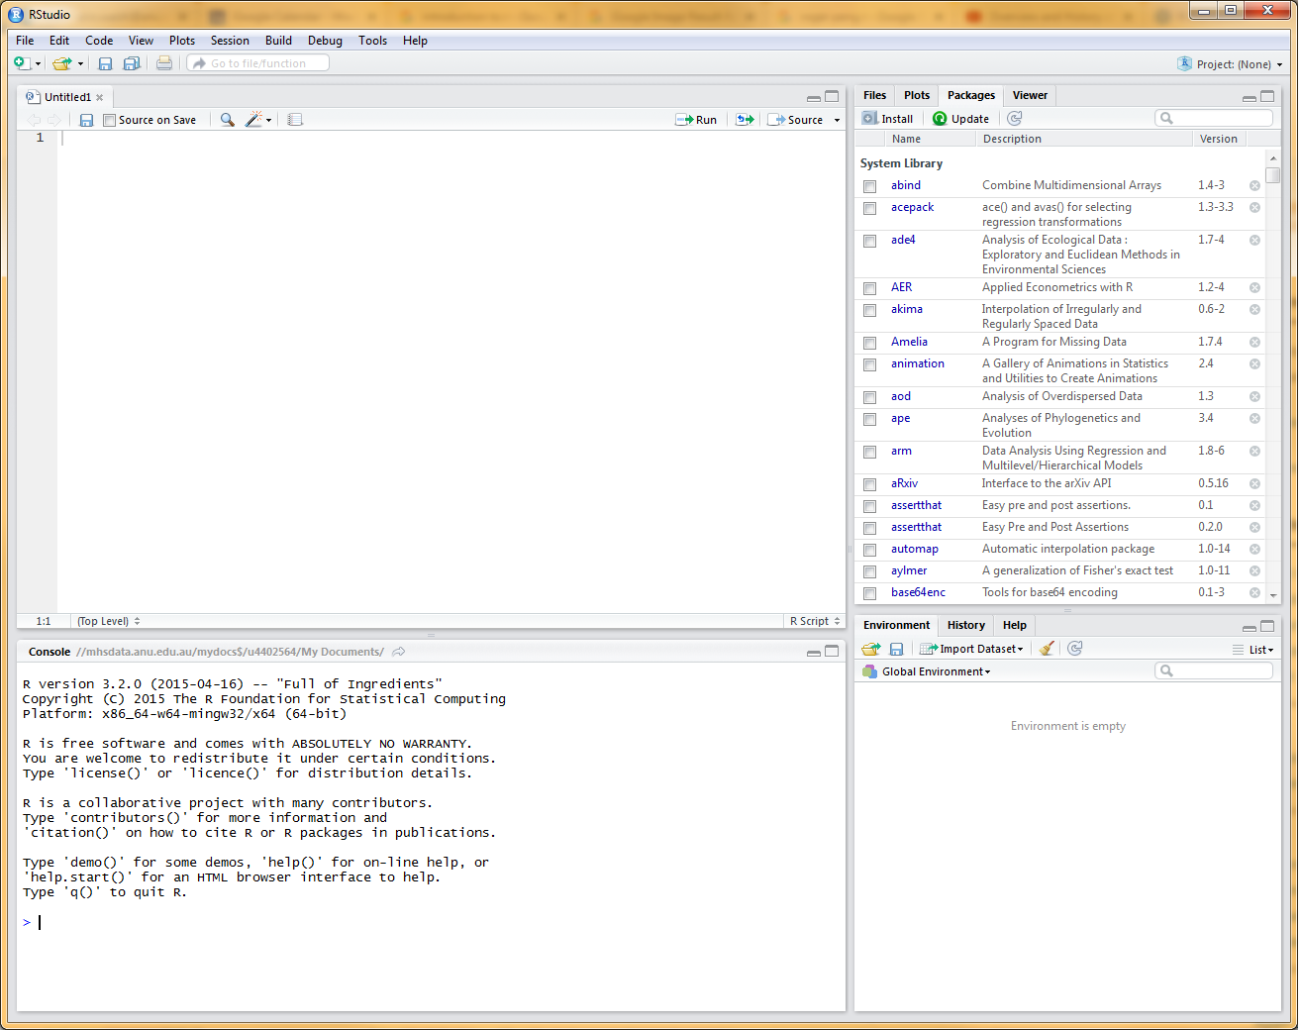
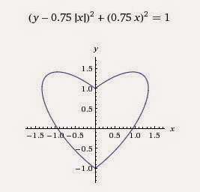
Last time…
Learning R is an excellent idea (free!)
Rstudio is your gateway into the full power of R
The whole process of data -> analysis -> reporting can be reproducible (This minimises human error and increases transparency)
Image from: http://3.bp.blogspot.com/-os4wGSnoRxk/U-iIVxN-OjI/AAAAAAAAGH4/t0JTmnNyYLs/s1600/Heart,+mathematical+equation,+2D+1+-+0b.jpg

Slide 3
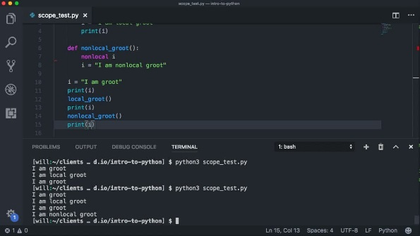
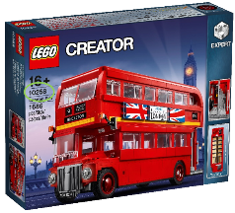
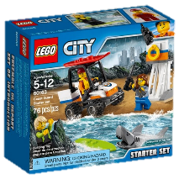

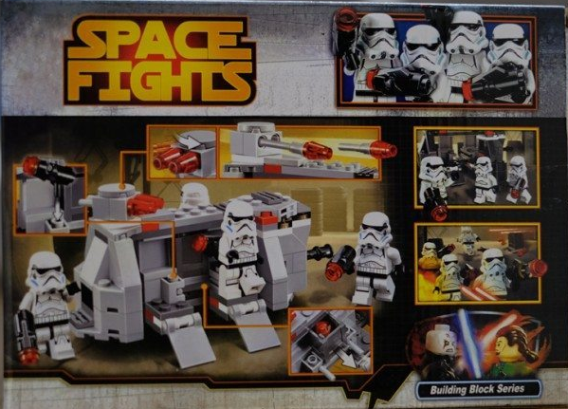

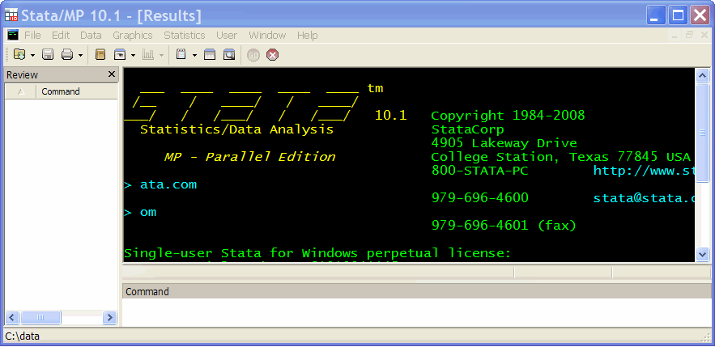

Slide 4
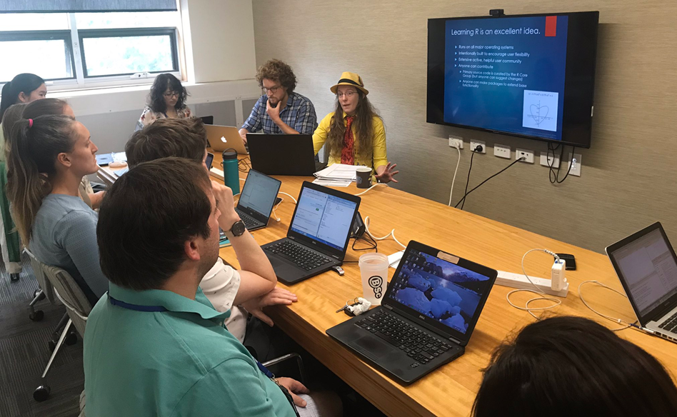
R orientation redux
Refresher walk-through on:
Variable assignment
Functions
Loops
Scripts
Importing data
last_month<- “happy memories, fun times”

Slide 5
R Markdown
A file format for making dynamic documents
Like a script, but does more: Contains chunks of embedded R code alongside neatly formatted text.
Makes the WHOLE process reproducible and flexible and this is brilliant.
But first, let’s make sure it is installed and working…

Slide 6
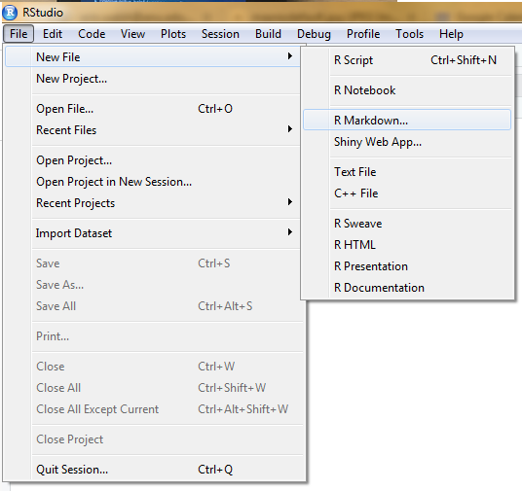
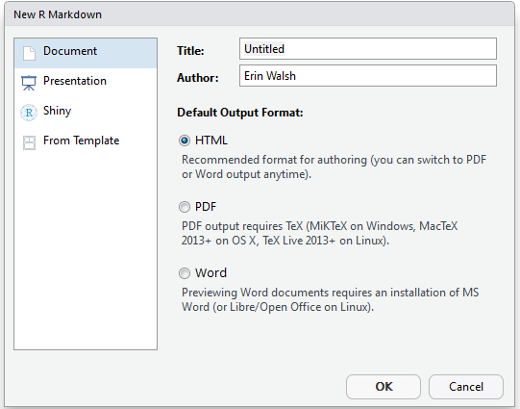
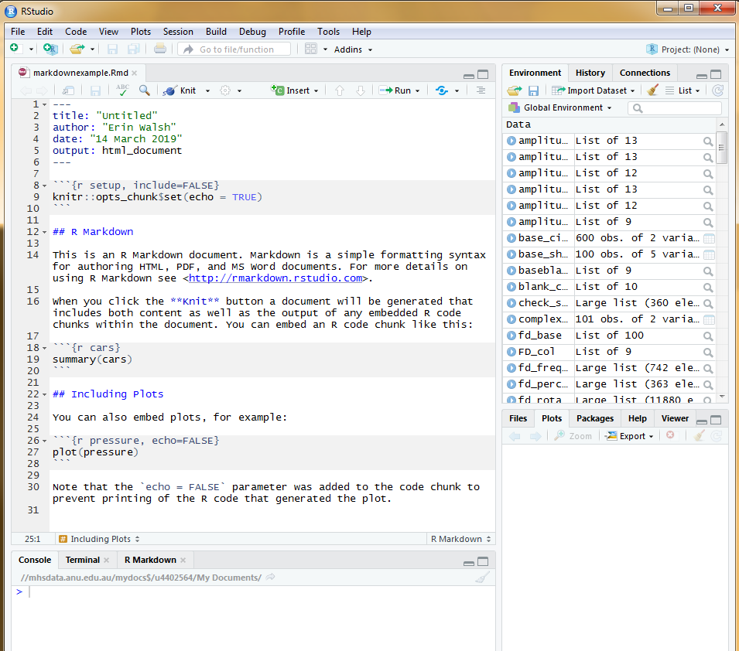


Slide 7
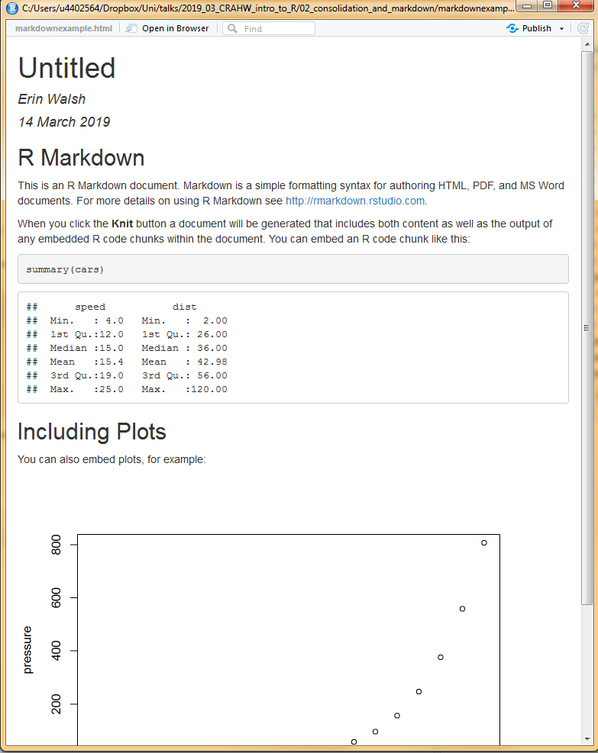


Slide 8
What is Markdown?
Markup language
a system for annotating a document in a way that is syntactically distinguishable from the text.
Not completely “what you see is what you get”
Akin to the invisible formatting cues text editors like Word use for styles
Markdown is…
Lightweight, portable, and human readable
No need to know fancy code
Extremely extensible (as complex as you want it to be)
Flexible – can output to HTML, .doc, .pdf…
Widely used for readme files, documentation, back-end of blogs and websites (ubiquitous in Github!)
Growing application in reproducible analysis

Slide 9
R Markdown
R Markdown is a subset for making dynamic documents with R code.
Conveniently, Rstudio already has R Markdown integration ☺

Slide 10


Ok, but what does it do?
Takes care of text formatting (headings, lists, bolds, italics, links, images, blockquotes, tables)
Allows blocks of code

Slide 11

Ok, but what does it do?
Takes care of text formatting (headings, lists, bolds, italics, links, images, blockquotes, tables)
Allows blocks of code
Runs the code each time the document is compiled

Slide 12

Ok, but what does it do?
Takes care of text formatting (headings, lists, bolds, italics, links, images, blockquotes, tables)
Allows blocks of code
Runs the code each time the document is compiled
Can pipe the results from code into the text

Slide 13

Ok, but what does it do?
Takes care of text formatting (headings, lists, bolds, italics, links, images, blockquotes, tables)
Allows blocks of code
Runs the code each time the document is compiled
Can pipe the results from code into the text
Can use HTML code and other neat tricks to make the document convenient to read

Slide 14

Ok, but what does it do?
Entirely reproducible workflow that keeps your analysis in the same place as your reporting!

Slide 15
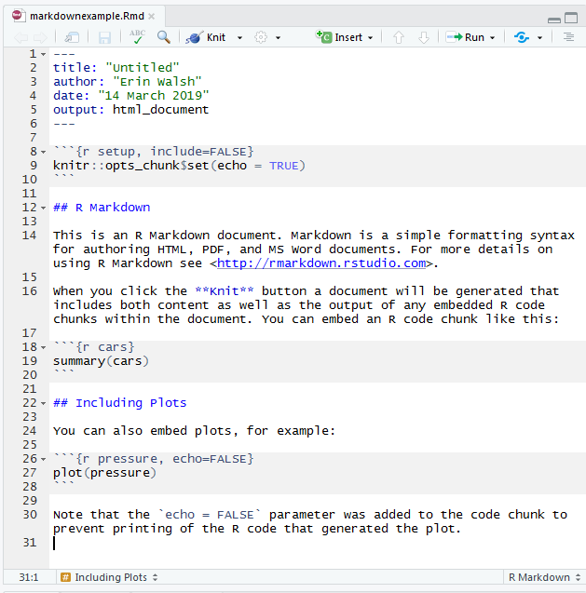
Four aspects…
Chunk content
Chunk options
From within to outside
Outside the code chunks

Slide 16
Part 1: Chunk content
Within a code chunk:
Variable assignment
Data importing
Model fitting
Stargazer
Chunks run contiguously from top to bottom (and that can be very useful)
Exercise time!

Slide 17
Part 2: Chunk options
Chunk options
include = FALSE
Neither the code nor the output will appear in the final document, but it will run and be available for later chunks.
Most useful: basic setup (packages, importing data etc)
echo = FALSE
The code will not appear, but the output will
Most useful: figures and tables
message = FALSE and warning = FALSE
Prevents messages that are generated by code from appearing in the finished file.
A final touch if you want a clean look.
results='asis’
Reports results as they are: very powerful in combination with Stargazer exporting to html
Exercise time – let’s try it all!

Slide 18
Part 3: From within to outside
Topically piping results from inside chunks into text:
If you wanted to you could write your results section while data collection is ongoing.
Any variable can be piped (numbers, model results, strings)
Can be used in combination with an IF statement so results in words will always match the numbers.
Exercise time

Slide 19
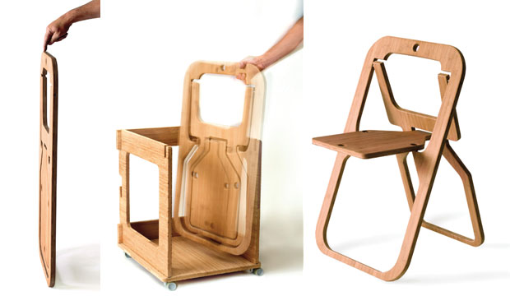
Part 4: Outside the chunks
Basic text formatting
Section folding
Image from: https://www.fastcompany.com/

Slide 20
Basic text formatting
<! –- Comments> don’t show up
# Heading 1 ## Heading 2 ### Heading 3 #### Heading 4
*italics*
**bold**
~~strikethrough~~
---
> Quote
[link text](http://www.linkurl.com)

Slide 21
Section folding
Compile reports that look neat, but contain everything.
Uses javascript DIV code, only works if compiling to HTML
Place this code at the top of the document, just under the --- which denotes the header
Place this code at the start of where you wish to fold
Place this code at the bottom of where you wish to fold
NAME you choose must be marched at the open/close of the DIVs
You can have as many folds as you want, just update the NAME
<script type="text/javascript" language="JavaScript"><!--
function HideContent(d) {
document.getElementById(d).style.display = "none";
}
function ShowContent(d) {
document.getElementById(d).style.display = "block";
}
function ReverseDisplay(d) {
if(document.getElementById(d).style.display == "none") { document.getElementById(d).style.display = "block"; }
else { document.getElementById(d).style.display = "none"; }
}
//--></script>
<a href="javascript:ShowContent('NAME')">Show </a>
<a href="javascript:HideContent('NAME')"> (hide)</a>
<div id="NAME" style="display:none;">
<a href="javascript:HideContent('NAME')">Hide</a>
</div>
<p></p>

Slide 22

Conclusion
Learning R is an excellent idea!
High five, you’ve taken the plunge
Markdown is a great gateway to truly reproducible science
Rmarkdown is convenient and powerful

